Slide 1
Netflix Movies and TV Shows
CAPSTONE PROJECT
Presented By:
Abirami.A-Shanmuganathan Engineering College - Civil engineering dpt

Slide 2
OUTLINE
Problem Statement
Proposed System/Solution
System Development Approach
Algorithm & Deployment
Result
Conclusion
Future Scope
References

Slide 3
Problem Statement
Netflix is one of the most popular media and video streaming platforms. They have over 8000 movies or tv shows available on their platform, as of mid-2021, they have over 200M Subscribers globally.
This tabular dataset consists of listings of all the movies and tv shows available on Netflix, along with details such as - cast, directors, ratings, release year, duration, etc.
Netflix wants to improve its content recommendation system to enhance user engagement and retention.
The current recommendation system lacks personalization and does not effectively capture user preferences, leading to suboptimal user experience.
Netflix aims to analyze user behavior and content preferences to develop a more accurate and personalized recommendation system.

Slide 4
Proposed Solution
Netflix can develop a more effective recommendation system that enhances user satisfaction, increases engagement, and ultimately drives subscriber retention and growth.
Google Colab provides a convenient and scalable environment for conducting data analysis, model development, and experimentation with large-scale datasets.

Slide 5
System Approach
Import Necessary Libraries: Import Python libraries that are required for data analysis, such as Pandas, NumPy, Matplotlib, and Seaborn.
Load Netflix Data: Load the Netflix dataset into your Colab notebook.
Explore and Preprocess Data: Explore the dataset to understand its structure, check for missing values, and preprocess the data if necessary (e.g., data cleaning, feature engineering).
Analyze Data: Conduct exploratory data analysis (EDA) to gain insights into user behavior, content preferences, and other relevant factors. This may involve visualizations, statistical analysis, and machine learning techniques.

Slide 6
Algorithm & Deployment
Data Preprocessing:
Cleaning the dataset by handling missing values and formatting data types.
Extracting relevant features for analysis.
Exploratory Data Analysis (EDA):
Analyzing various aspects of the dataset such as content ratings, directors, actors, and content production trends over the years.
Visualizing the data using plots like pie charts, bar charts, and line charts.
Sentiment Analysis:
Performing sentiment analysis on the descriptions of Netflix content using TextBlob.
Assigning sentiment labels (positive, negative, neutral) based on polarity scores.
Google Colab:
The algorithm was developed and executed in a Google Colab notebook.
Google Colab provides a free environment for running Python code, making it suitable for data analysis tasks.

Slide 7
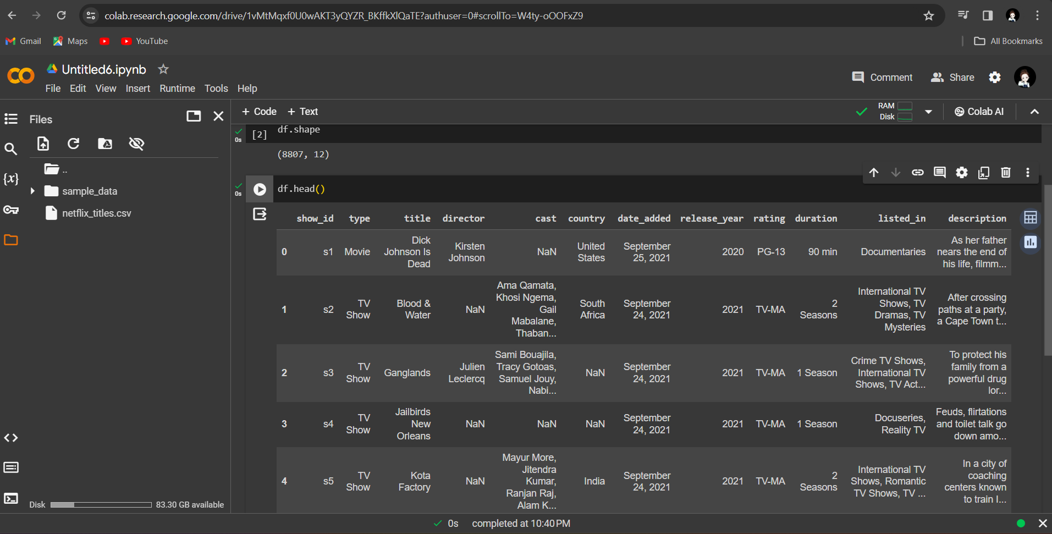
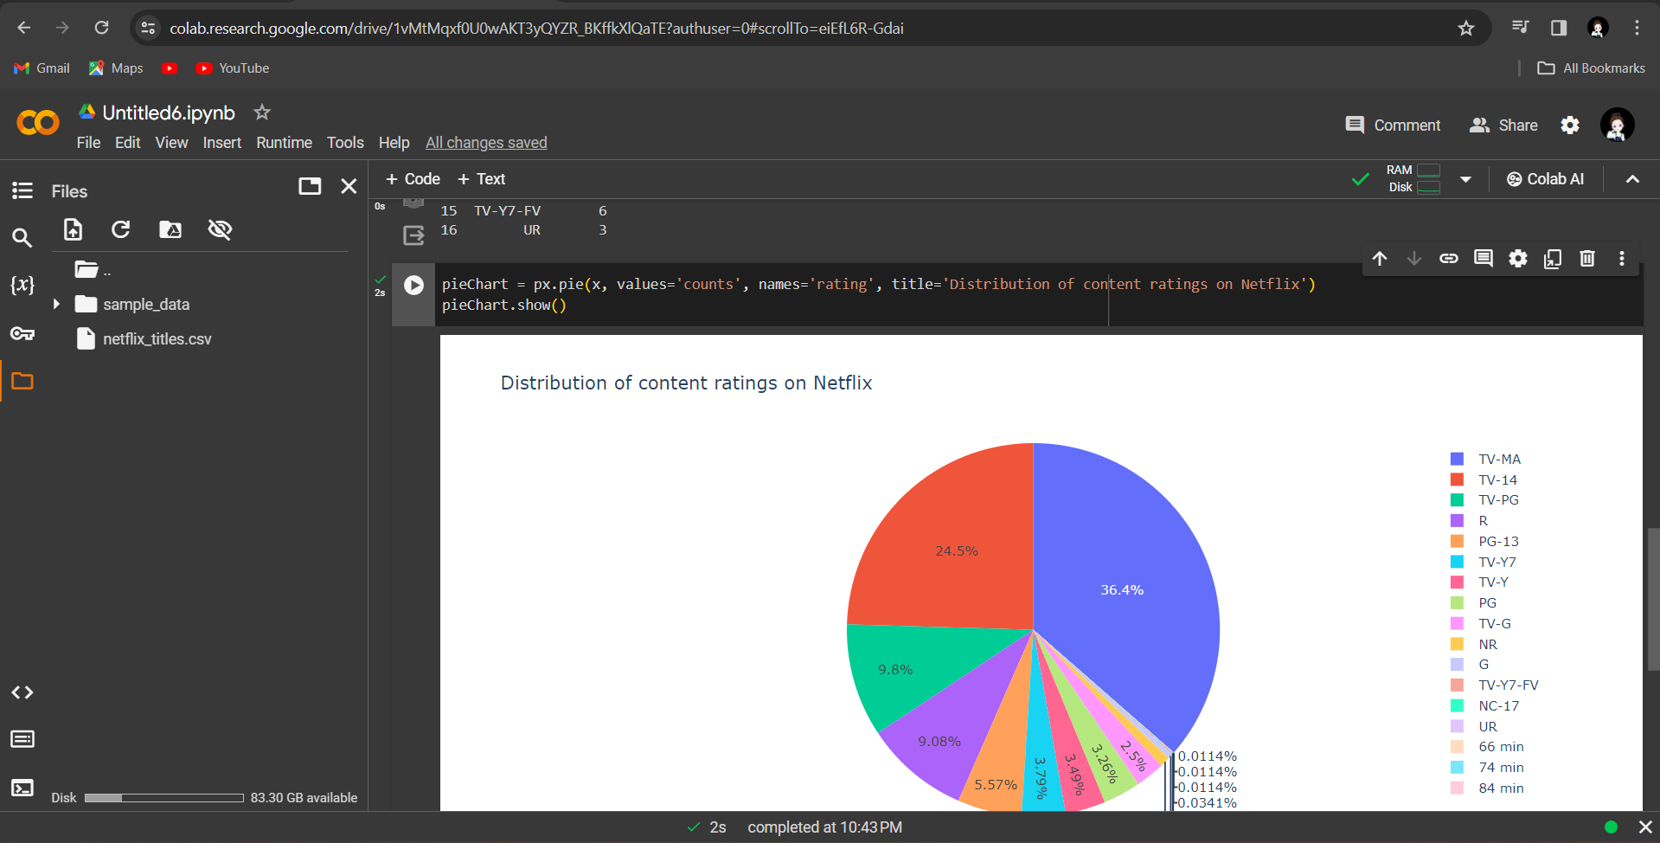
Result
Creating the Piechart based on Content rating
Analyzing the top 5 Directors on Netflix

Slide 8
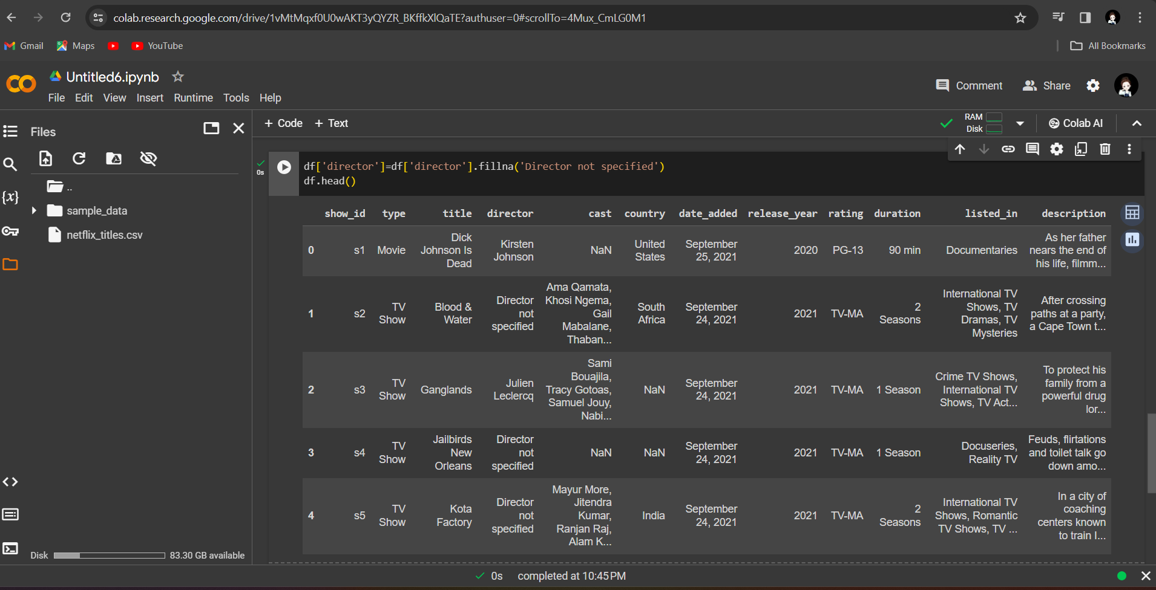
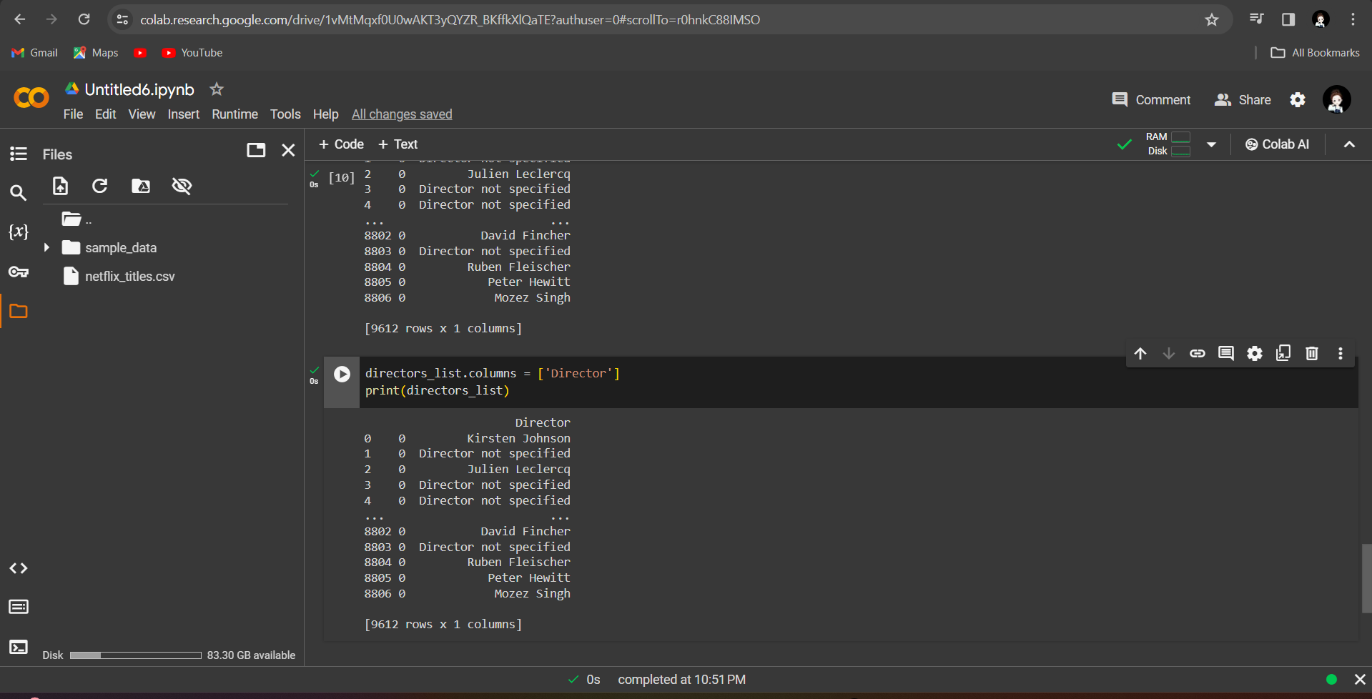
Result
Analyzing the content produced on netflix based on years

Slide 9
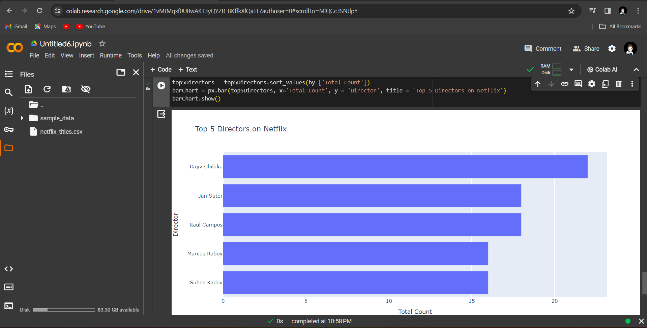
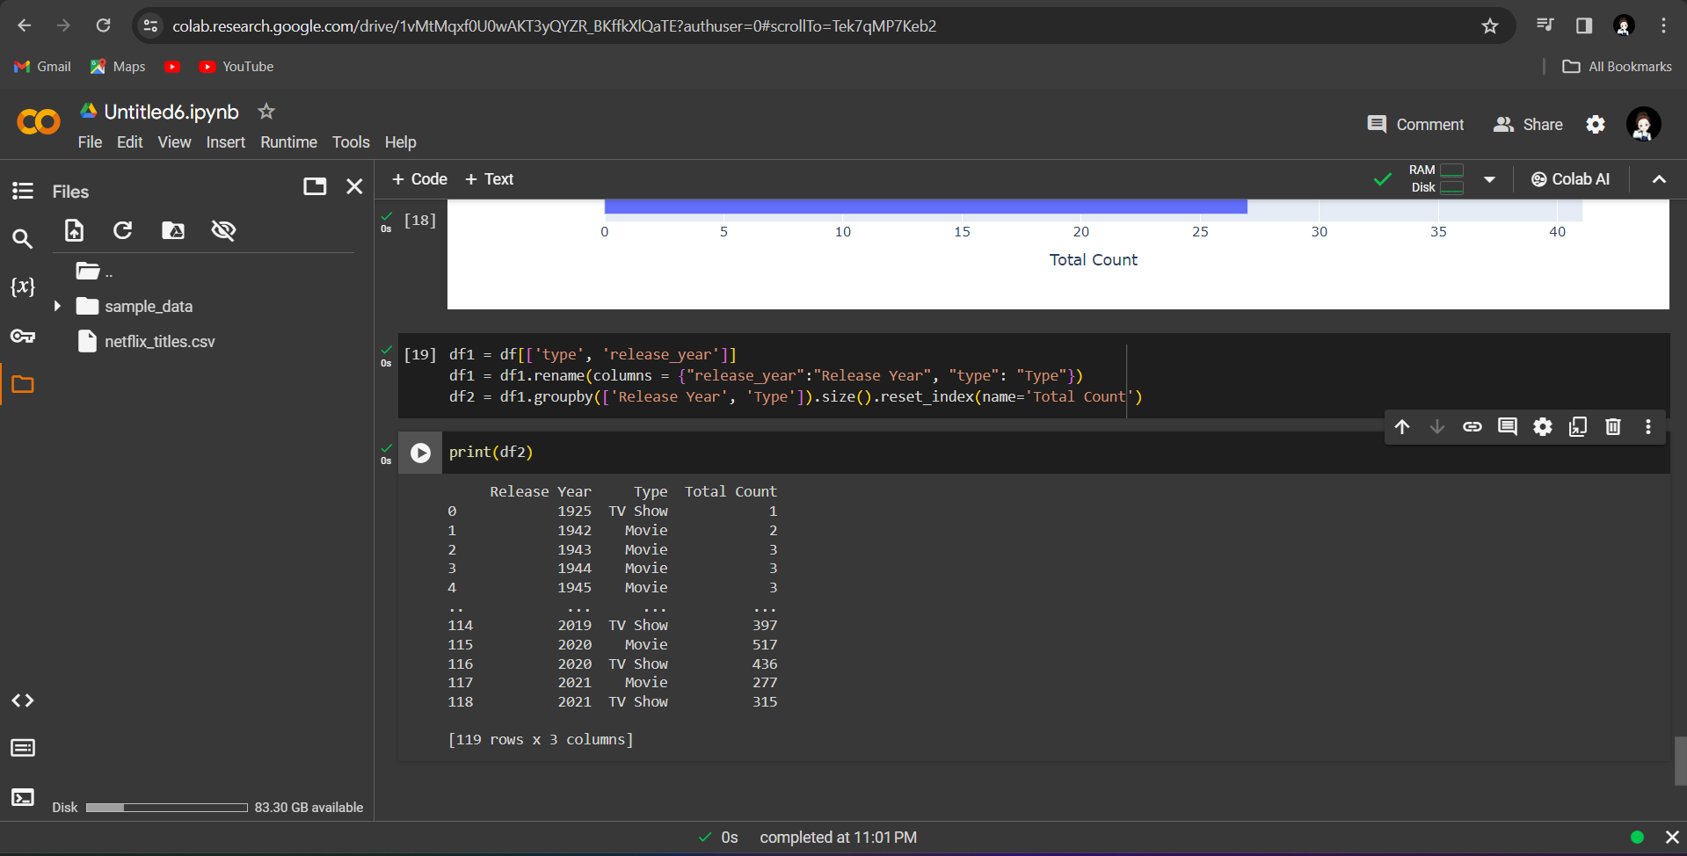
Result
Analyzing the top 5 Actors on Netflix
Analyzing the content produced on netflix based on years

Slide 10
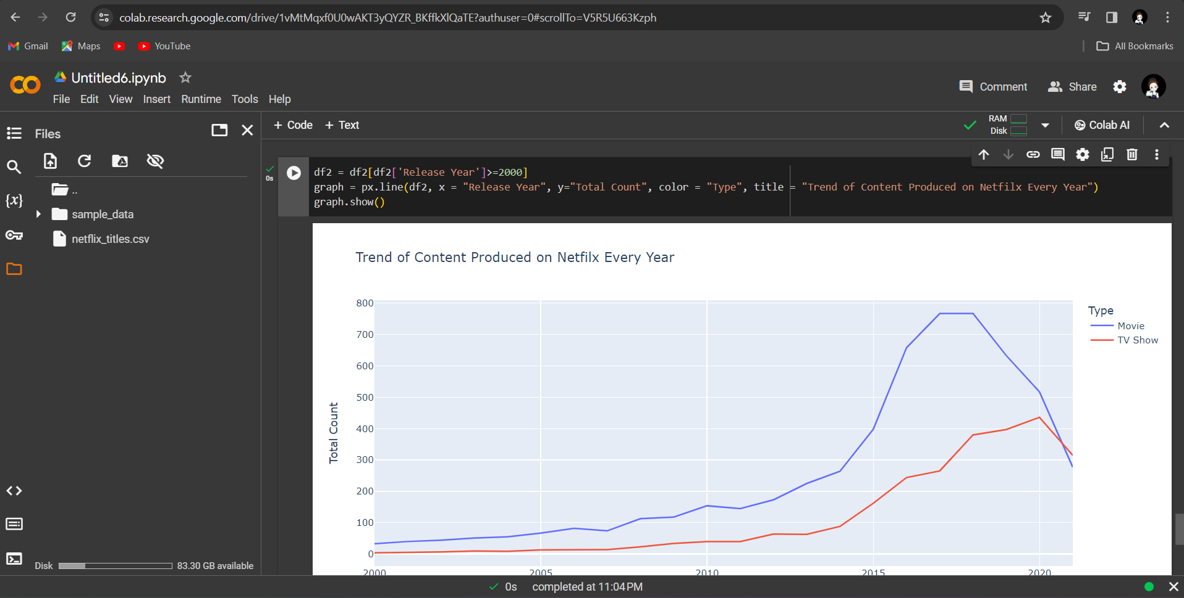
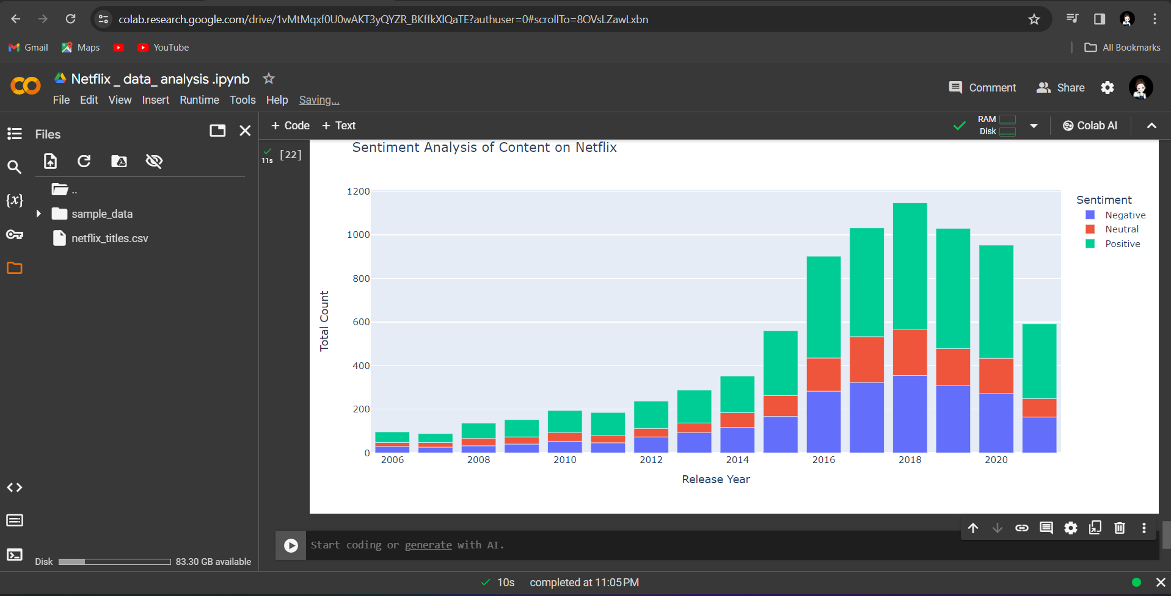
Result
Sentiment Analysis of Netflix Content

Slide 11
Conclusion
Based on the analysis, we can conclude that Netflix offers a diverse range of content with various ratings, directors, actors, and production trends.
The sentiment analysis provides an additional layer of understanding regarding the emotional tone of the content descriptions.
Overall, the analysis helps in gaining insights into Netflix's content landscape, which can be valuable for content creators, viewers, and decision-makers within the streaming industry.

Slide 12
Future scope
Model Optimization:
Continuously optimize the algorithm based on feedback and performance metrics.
Experiment with different algorithms and hyperparameters to improve accuracy and efficiency.
Real-time Updates:
Implement mechanisms to incorporate real-time data updates into the analysis.
Use streaming data processing techniques for handling continuous data streams.
Advanced Analysis Techniques:
Explore advanced analysis techniques such as deep learning for more complex modeling tasks.
Incorporate user feedback and preferences into the analysis for personalized recommendations.

Slide 13
References
https://www.kaggle.com/datasets/shivamb/netflix-shows
https://colab.research.google.com/github/A2b0i04/Abirami.A-/blob/main/Netflix___data__analysis_.ipynb
https://github.com/A2b0i04/Abirami.A-/blob/main/Netflix___data__analysis_.ipynb
ppt using wsp office

Slide 14
THANK YOU

